Slide 1
Chapter 3: Image processing and computer vision Edge detection and image filtering
by Prof. K.H. Wong,
Computer Science and Engineering Dept. CUHK
khwong@cse.cuhk.edu.hk

Slide 2
You will learn
Introduction: Edge detection by differentiation and threshold
Convolution math tool
Edge mask : edge detection by convolution (e.g. Sobel)
Image Filtering: smoothing, high pass etc.
Laplacian method : 2nd order derivative method.
Laplacian of Gaussian :LOG smoothing and edge detection together
Canny Edge Detection: Most popular method

Slide 3
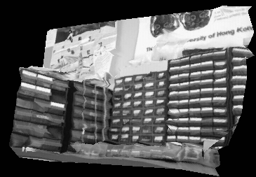
Topics
Edge detection
First order derivative G(I)
Second order derivative ∇²I
A gray level image I
has many sharp edges

Slide 4
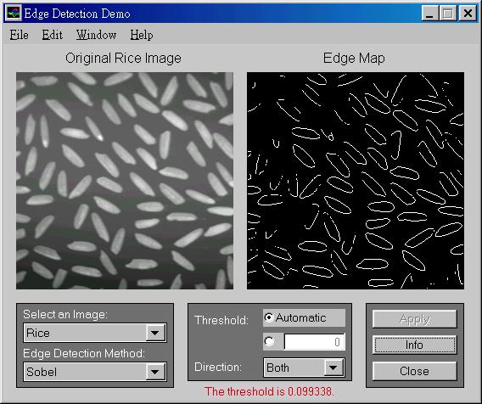
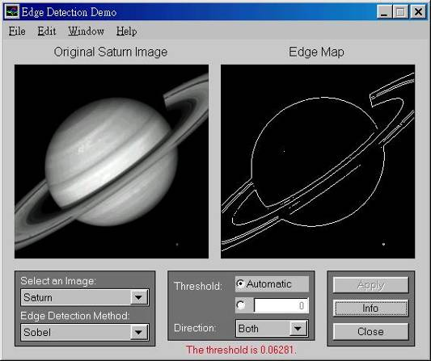
What are edges and why we need them?
Features have many applications: recognition, tracking etc.
The most common are
Point edges
Shape intensity change positions
Boundary edges
Shape intensity changing lines

Slide 5
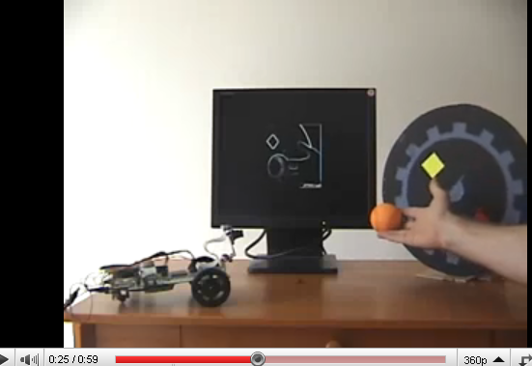
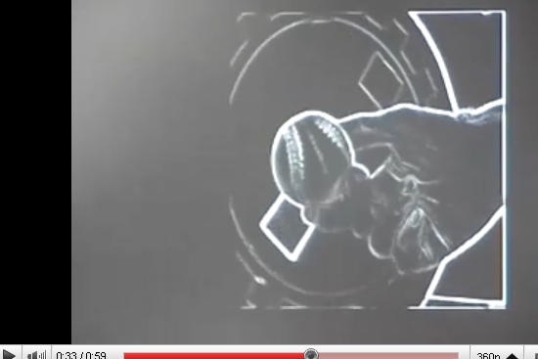
Sobel Demo
http://www.youtube.com/watch?v=z_a6e30aOXo

Slide 6
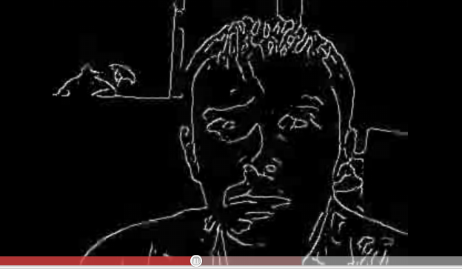
Face edges
Demo
http://www.youtube.com/watch?v=CDlLe-53a0w

Slide 7
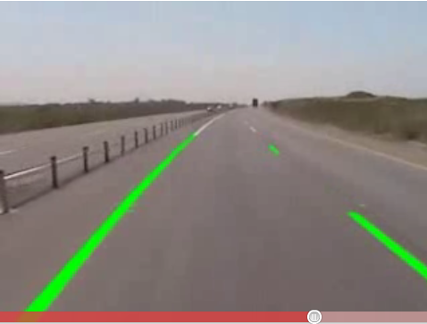
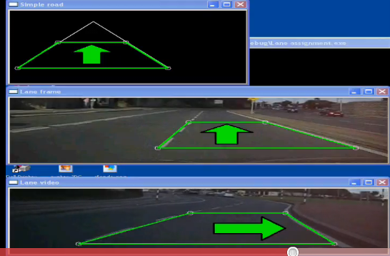
Application of edges
Lane detection
http://www.youtube.com/watch?v=Al4DnNkZUeA&feature=related
http://www.youtube.com/watch?v=9F3_6xL8hEY&feature=related

Slide 8
How to obtained edges?
I(x,y+1) I(x+1,y+1)
I(x,y) I(x+1,y)
Use gradient G of intensity [I(x,y)] change, two methods
First order gradient
I(x,y) is an edge if
Second order gradient (Laplacian operator)
I(x,y) is an edge if
I(x,y)
y
x

Slide 9
Edge detection using First order gradient G > threshold
Edges are at positions of rapid change of intensity levels
If (intensity gradient G(I(x,y))> threshold)
{
pixel(x,y) is an edge point;
}
I(x,y)
G[I(x,y)]=> threshold is an edge
First order derivative

Slide 10
Edge detection using second order gradient ∇²I=0
Edges are at ∇²I =0
If (intensity gradient ∇²I =0)
{
pixel(x,y) is an edge point;
}
I(x,y)
I(x,y)
G[I(x,y)]=> threshold is an edge
∇²I(x,y)= 0 is an edge
x
First order derivative
(gradient of I(x,y))
Second order derivative
(gradient of gradient of I(x,y))
x
x

Slide 11
Practical computational methods (discrete method for finding first order gradient)
First order gradient operators
Roberts operator
Prewiit operator
Sobel operator

Slide 12
Convolution method
Convolution is an important and popular technique in signal processing
Edges can found by convoluting an image with a mask

Slide 13
Gradient calculation by convolution*
Differentiate an image I w.r.t x
G(I)=gradient of I= dI/dx
It is the same as
dI/dx ≈ (d/dx)*I
Gradient mask
Or filter mask
*=Convolution operator

Slide 14
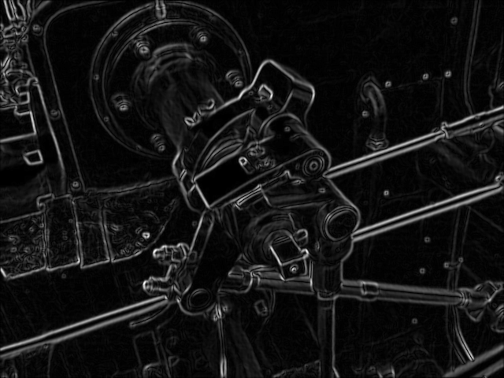
Assume Gx,Gy are separable, the total gradient Gm becomes
Horizontal gradient =G_{x}(i,j)= h_A * I(i,j)
vertical gradient= G_{y}(i,j)= h_B * I(i,j)
here,
Horizontal
direction
vertical
direction
* is the
convolution operator
θ_{e}
An edge is found
and direction is tan⁻¹(Gy/Gx)=θ_{e}

Slide 15
What is convolution ? Discrete convolution C=I*h
By definition (http://en.wikipedia.org/wiki/Convolution)
X=multiplication
*=convolution

Slide 16
Convolution is
Commutative : g(n)*h(n)=h(n)*g(n)
associative: {x(n)*g(n)}*h(n)=x(n)*{h(n)*g(n)}
Distributive
x(n)*{g(n)+h(n)}=x(n)*g(n)+x(n)*h(n)
Application: to edge finding
In practice : only accept convoluted values obtained when edge mask and image are fully overlapped.

Slide 17


1-D convolution examples
http://en.wikipedia.org/wiki/Convolution
Example 1
Example 2

Slide 18
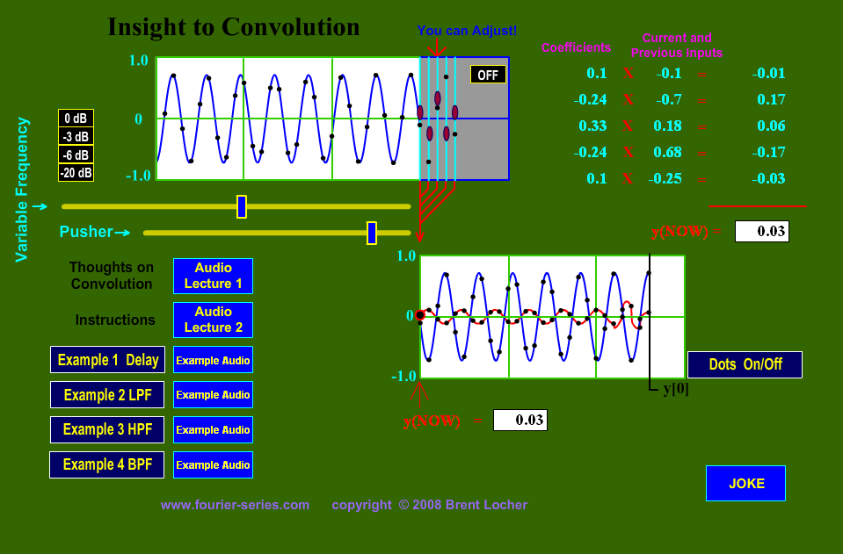
Another demo
http://www.fourier-series.com/fourierseries2/flash_programs/Convolution/index.html

Slide 19
Discrete convolution: Correlation is more intuitive
so we use correlation of the flipped version of h to implement convolution[1]
convolution
Flipped h
correlation

Slide 20
Matlab (octave) code for convolution
I=[1 4 1;
2 5 3]
h=[1 1 ;
1 -1]
conv2(I,h)
pause
disp('It is the same as the following');
conv2(h,I)
pause
disp('It is the same as the following');
xcorr2(I,fliplr(flipud(h)))

Slide 21
Correlation is more intuitive, so we use correlation to implement convolution.
k
k
k=1
k=0
j=0 1 2
j
j=0 1
j
Flip h
k
j=0 1
j
Discrete convolution I*h, flip h ,shift h and correlate with I [1]

Slide 22
Discrete convolution I*h, flip h ,shift h and correlate with I [1]
k
k
n
j
j
j=0 1
C(m,n)
Flip h: is like this after the flip
and no shift (m=0,n=0)
k
m
The trick: I(j=0,k=0) needs to multiply to h^{(flip)}(-m+0,-n+0), since m=1, n=0, so we shift the h^{(flip)} pattern 1-bit to the right so we just multiply overlapped elements of I and h^{(flip)}. Similarly, we do the same for all m,n values
j
Shift Flipped h to m=1,n=0
k
j

Slide 23
Find C(m,n)
Shift Flipped h to m=1,n=0
K
K
J
J
multiply overlapped elements
and add (see next slide)

Slide 24
Find C(m,n)
Shift Flipped h to m=1,n=0
K
K
n
C(m,n)
J
J
m
multiply overlapped elements
and add

Slide 25
Steps to find C(m,n)
Step1:
C(0,0)
=1x2=2
Step 2:
C(1,0)
= -1*2+1*5=3
Step 3:
C(2,0)
= -1*5+1*3
=-2
Step 4:
C(3,0)
= -1*3
=-3
1 | 4 | 1
2 | 5 | 3
1 | 4 | 1
2 | 5 | 3
-1 | 1
1 | 1
-1 | 1
1 | 1
1 | 4 | 1
2 | 5 | 3
1 | 4 | 1
2 | 5 | 3
-1 | 1
1 | 1
-1 | 1
1 | 1
C(0,0) | C(1,0) | C(2,0) | C(3,0)
C(0,0) | C(1,0) | C(2,0) | C(3,0)
C(0,0)=2 | C(1,0)=3 | C(2,0)=-2 | C(3,0)=-3
C(m,n)=

Slide 26
Steps continue
1 | 4 | 1
2 | 5 | 3
Step 5:
C(0,1)
=1x1+1*2
=3
Step 6:
C(1,1)
= -1*1+1*4+1*2+1*5
=10
Step 7:
C(2,1)
= -1*4+1*1+1*5+1*3
=5
Step 8:
C(3,1)
= -1*1+1*3
=2
1 | 4 | 1
2 | 5 | 3
-1 | 1
1 | 1
-1 | 1
1 | 1
1 | 4 | 1
2 | 5 | 3
-1 | 1
1 | 1
1 | 4 | 1
2 | 5 | 3
-1 | 1
1 | 1
C(0,2) | C(1,2) | C(2,2) | C(3,2)
C(0,1)=3 | C(1,1)=10 | C(2,1)=5 | C(3,1)=2
C(0,0)=2 | C(1,0)=3 | C(2,0)=-2 | C(3,0)=-3
C(m,n)=

Slide 27
Find all elements in C for all possible m,n
n
C(m,n)
n
m
m

Slide 28
Exercise 3.1
I=[1 4 1;
2 5 3
3 5 1]
h2=[-1 1
1 -1]
Find convolution of I and h2.

Slide 29
Answer ws5711_3_1
%ws3.1 edge
I=[1 4 1;
2 5 3
3 5 1]
h2=[-1 1
1 -1]
%Find convolution of I and h2.
conv2(I,h2)
%
% ans =
%
% -1 -3 3 1
% -1 0 -1 2
% -1 1 2 -2
% 3 2 -4 -1

Slide 30
Exercise 3.2: Find edge image using filter masks h_A and h_B
Horizontal edge mask
Vertical edge mask

Slide 31
Answer5711, 3.2
J=[0 0 0 0
0 0 0 0
0 0 1 1
0 0 1 1]
h_x=[0 0 0
-1 0 1
0 0 0]
h_y=[0 1 0
0 0 0
0 -1 0]
conv2(J,h_x)
conv2(J,h_y)
Gx=conv2(J,h_A) %horizonatal edge image
ans =
0 0 0 0 0 0
0 0 0 0 0 0
0 0 0 0 0 0
0 0 -1 -1 1 1
0 0 -1 -1 1 1
0 0 0 0 0 0
Gy=conv2(J,h_B) %vertical edge image
ans =
0 0 0 0 0 0
0 0 0 0 0 0
0 0 0 1 1 0
0 0 0 1 1 0
0 0 0 -1 -1 0

Slide 32
Edge direction
Θ(x,y) = tan⁻¹(Gy(x,y) / Gx(x,y))

Slide 33
Edge mask
Convolution is useful in many image processing applications
For each application what you need is to design a mask for that task
You can use different masks for various applications
E.g. Edge detection masks
Prewitt, Sobel etc.
Image smoothing
High pass: Edge highlighting

Slide 34
Other simple 3x3 gradient operators (In practice : only accept convoluted values obtained when edge mask and image are fully overlapped. The size of the image is usually much bigger than the masks)
Two types of operators

Slide 35
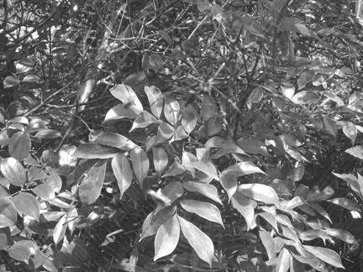
Convolution of a mask to a picture
In theory all overlapped and non-overlapped areas are considered.
But in practice: Non-fully-overlapped areas are usually ignored. Only fully overlapped mask and Image I is considered.
The effect of this is small
Size of the convolution result of a 3x3 mask and I_{1024x768} is (1024-2)x(768-2)
* I
Mask=3x3
I_{1024x768} =a 1024x768 image

Slide 36
Edge detection procedure
Input: Image I() , h_A, h_B
Output: edge_image edge()
For m=1,..,M
For n=1,…,N
Find Horizontal gradient =G_{x}(m,n)= h_A * I(m,n)
Find vertical gradient =G_{y}(m,n)= h_B * I(m,n)
Find overall_edge(m,n)=Gt(m,n)=sqrt{G_{x}(m,n)²+G_{y} (m,n)²}
If ( overall_edge(m,n)>threshold )
edge(m,n) is an edge
Else
edge(m,n) is not an edge.
End for
End for

Slide 37
Example to find edges, e.g. use Prewitt edge filter on image I
In practice outside or at m=1 and m=M-1 are not considered, because it is where image/mask are not fully overlapped. Same for n.
For m=2..,M-2
For n=2..,N-2
Gx(m,n)=h_A*I(m,n)
Gy(m,n)=h_B*I(m,n)
Gt(m,n)=sqrt{Gx(m,n)²+Gy(m,n)²}
If Gt(m,n)>Threshold
Edge(m,n)=1, else =0
End
End
done

Slide 38
Sobel masks
Sobel mask approximation
of a horizontal edge
Sobel mask approximation
of a vertcial edge

Slide 39
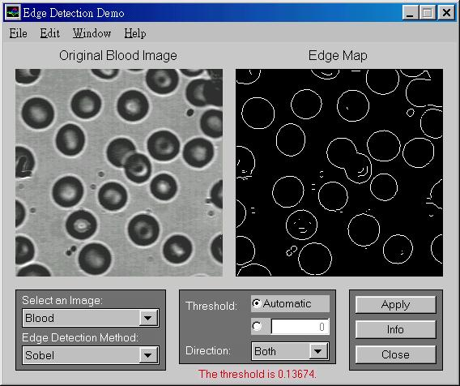
Using Sobel edge masks
Example

Slide 40
Another example

Slide 41
Exercise 3.3a: Example for intensity gradient calculation
Find edge image if G(I)>threshold using Prewitt operator and use threshold =1.
Exercise 3.3b: write a matlab program to find edges of a real image.

Slide 42
Answer 3.3a
%matlab answer for ws3_3.a---- edge filtering -----
%For edge mask and image partially
% overlapping case , after convolution
% you get two 6x6 matrices, say ex,ey.
% (Not a 4x6 %and a 6x4 matrix.).
%Of course for edge mask and image
%fully overlapping case, the resulting
%edge matrices ex,ey are only 2x2.%
%
clear
ii=[0 0 255 255; 0 0 255 255; 0 0 255 255; 0 0 255 255]
% ii = 0 0 255 255
% 0 0 255 255
% 0 0 255 255
% 0 0 255 255
prew_x=[-1 0 1; -1 0 1; -1 0 1]
% prew_x = -1 0 1
% -1 0 1
% -1 0 1
ex=conv2(ii, prew_x)
% ex = 0 0 -255 -255 255 255
% 0 0 -510 -510 510 510
% 0 0 -765 -765 765 765
% 0 0 -765 -765 765 765
% 0 0 -510 -510 510 510
% 0 0 -255 -255 255 255
prew_y=[1 1 1; 0 0 0; -1 -1 -1]
% prew_y = 1 1 1
% 0 0 0
% -1 -1 -1
ey=conv2(ii, prew_y)
% ex = 0 0 255 510 510 255
% 0 0 255 510 510 255
% 0 0 0 0 0 0
% 0 0 0 0 0 0
% 0 0 -255 -510 -510 -255
% 0 -255 -510 -510 -255
%==== furthermore =============
%If edge image is required:
%% for all x,y
% e(x,y)=sqrt(ex(x,y)^2+ey(x,y)^2) %for all x and y
% if e(x,y) > threshold
% e(x,y) =1
% else
% e(x,y) =0
% end if
% end for
%Then you get the edge image edge(x,y)
%% matlab implementation: no need to use loop but has same effect as above
etemp=sqrt(ex.*ex+ey.*ey)
e=etemp;
threshold=500 % set threshold, choose any value you like
e(e<=threshold)=0; %smaller than threshold , set to 0
e(e>threshold)=1%bigger than threshold , set to 1
% Answer:
%etemp =
% 0 0 360.6245 570.1973 570.1973 360.6245
% 0 0 570.1973 721.2489 721.2489 570.1973
% 0 0 765.0000 765.0000 765.0000 765.0000
% 0 0 765.0000 765.0000 765.0000 765.0000
% 0 0 570.1973 721.2489 721.2489 570.1973
% 0 0 360.6245 570.1973 570.1973 360.6245
%threshold = 500
%e =
% 0 0 0 1 1 0
% 0 0 1 1 1 1
% 0 0 1 1 1 1
% 0 0 1 1 1 1
% 0 0 1 1 1 1
% 0 0 0 1 1 0

Slide 43
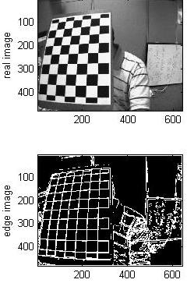
Answer 3.3b Find edge of real images (tested on octave too)
%ws3_3b.m find edge image of a real image,
%put test.jpg in c:\images\ ,tested ok on octave
clear
ii=imread('c:\\images\\test.jpg');
prew_x=[-1 0 1; -1 0 1; -1 0 1]
ex=conv2(ii, prew_x);
prew_y=[1 1 1; 0 0 0; -1 -1 -1]
ey=conv2(ii, prew_y);
%If edge image is required:
etemp=sqrt(ex.*ex+ey.*ey);
e=etemp;
threshold=mean(mean(etemp))% set threshold
e(e<=threshold)=0; %< threshold, set to 0
e(e>threshold)=255;%> threshold, set to 255
figure(1),clf
subplot(2,2,1)
colormap(gray(256))
image(ii)
ylabel('real image')
subplot(2,2,3)
colormap(gray(256))
image(e)
ylabel('edge image')

Slide 44
Image filtering You may design a mask for Low pass filtering (smoothing filter)
Low pass

Slide 45
Other image processing operators
Low pass (or called smoothing filter, blurring filter pixel or averaging filter)
This term is to normalize the pixel value after the operation

Slide 46
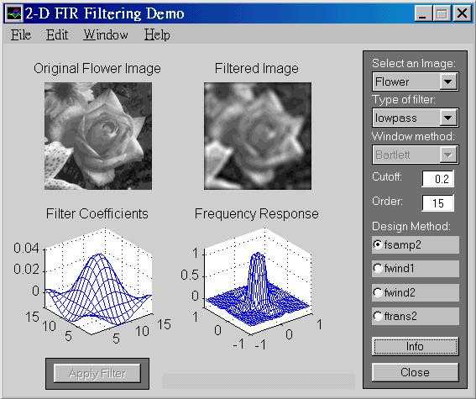
Low pass filtering result

Slide 47
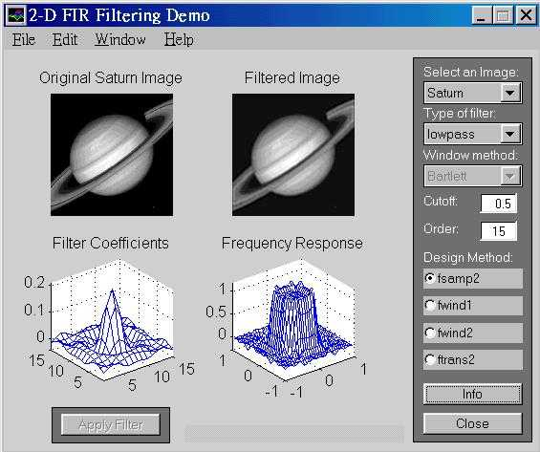
Low pass filtering result

Slide 48
Exercise 3.4 low pass filtering
Use the low pass filter to filter image I.

Slide 49
Answer: Exercise 3.4
%-answer for ws3.4 -- low pass filtering (smoothing)
hlow=[1 1 1; 1 2 1 ; 1 1 1]
ii=[0 0 255 255
0 0 255 255
0 0 255 255
0 0 255 255];
% hlow =
% 1 1 1
% 1 2 1
% 1 1 1
smooth_ii=(1/10)*conv2(ii,hlow)
% answer
%
% smooth_ii =
%
% 0 0 25.5000 51.0000 51.0000 25.5000
% 0 0 51.0000 127.5000 127.5000 51.0000
% 0 0 76.5000 178.5000 178.5000 76.5000
% 0 0 76.5000 178.5000 178.5000 76.5000
% 0 0 51.0000 127.5000 127.5000 51.0000
% 0 0 25.5000 51.0000 51.0000 25.5000
You can see
Blurred (I)=
I*h_low_pass
is now blurred

Slide 50
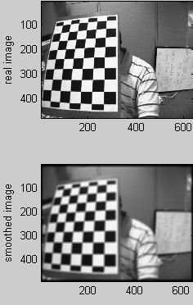
Answer worksheet 3.5 Smooth an image kernal size is 11x11
%smooth an image ws3_5.m,
%put test.jpg in c:\images\
clear
ii=imread('c:\\images\\test.jpg');
%smooth_kernal=[1 1 1 ; 1 2 1; 1 1 1];
%smooth_kernal=[0.1 0.1 0.1 ; 0.1 0.1 0.1; 0.1 0.1 0.1 ]
smooth_kernal=ones(11,11)
%optional:trust middle element more
%smooth_kernal(5,5)=11*11;
%this is to normalize the pixels
smooth_kernal=smooth_kernal/sum(sum(smooth_kernal))
smooth_ii=conv2(ii, smooth_kernal);
figure(1),clf
colormap(gray(256))
subplot(2,2,1)%----------------------
image(ii)
ylabel('real image')
subplot(2,2,3)%--------------------
image(smooth_ii)
ylabel('smoothed image')

Slide 51
Worksheet 3.5
Write the algorithm for smoothing an image.

Slide 52
A small summary
If you convolve an image I with an edge mask, you get an edge image.
If you convolve an image I with a smoothing mask, you get a smoothed image.

Slide 53
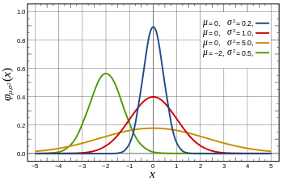
A more formal smoothing filter is the Gaussian filter
Smoothing_image(I)= Gaussian (I)
= Gaussain_mask*I
How to get the Gaussian mask?
See following slides
Probability density function
Standard Normal distribution:
Red line, when mean(μ)=0, Sigma (σ)=1)
http://en.wikipedia.org/wiki/Normal_distribution

Slide 54

Properties of Gaussian (Normal) distribution
Standard Normal distribution:
Red line, when mean(μ)=0, Sigma (σ)=1
At (x-μ)=0, σ =1
G(x) =1/sqrt(2*pi)=0.3989
At x=1*σ, drops off to
(1/sqrt(2*pi))*exp(-1^1/2)=0.2420
Area covered 68.2%
At x=2*σ, drops off to
(1/sqrt(2*pi))*exp(-2^2/2)= 0.0540
Area covered 95.44%
At x=3*σ, drops off to
(1/sqrt(2*pi))*exp(-2^2/2)= ?? (exercise)
Area covered 99.73%
Probability density function
G
G
Standard Normal distribution
Area covered
(total=
100%)
http://en.wikipedia.org/wiki/Normal_distribution

Slide 55
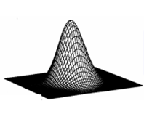
Gaussian (Normal) functions 1D,2D
G(x)
1-D Gaussian
x
μ
2-D Gaussian
y
x
μ_{y}
μ_{x}

Slide 56
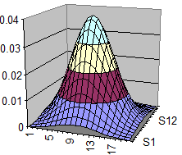
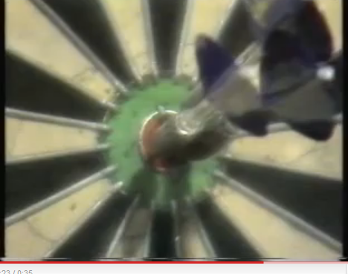
Intuition of Gaussian (Normal) distribution?
(mean_x,mean_y)
standard
deviation
(σ)
Week3
Like you play darts many times (e,g, 1000)
Aim at (mean_x,mean_y)
If you are good player , standard deviation (σ) is small. If you are bad, deviation (σ) is large.
The distribution is the counts of your dart landed at (x,y)
The distribution is Gaussian
x
y
Mean_x
mean_y
http://www.youtube.com/watch?v=2-EPvfFK1zw

Slide 57
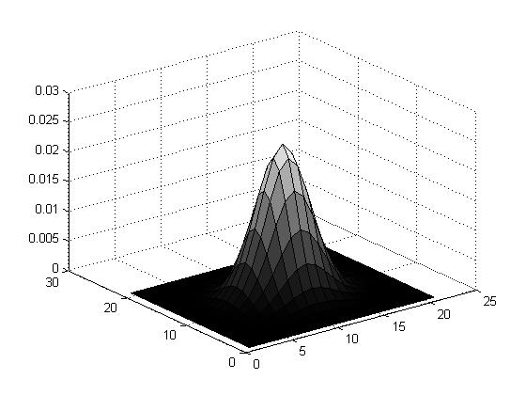
To generate a discrete (2N+1)x(2N+1) Gaussian mask for image processing
Knowing that at 4 σ it drops off to 0
Set σ =N/4 will give a useful Gaussian Mask (you can see it drops off to 0)
Example: N=10, mask size=21x21
Sigma=10/4=2.5; Peak =0.0255
Sum_all_elements=1
function demo_gauss_mask1 %matlab code
clear, N=10
[X,Y]=meshgrid(-N:N,-N:N);sigma =N/4;
G=1/(2*pi*sigma^2)*exp(-(X.^2+Y.^2)/(2*sigma^2));
G=G./sum(G(:)) %normalise it
'sigma is ', sigma
'sum(G(:)) is ',sum(G(:))
'max(max(G(:))) is',max(max(G(:)))
figure(1), clf
surfc(G)

Slide 58
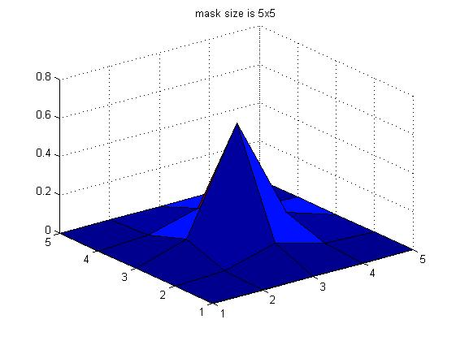
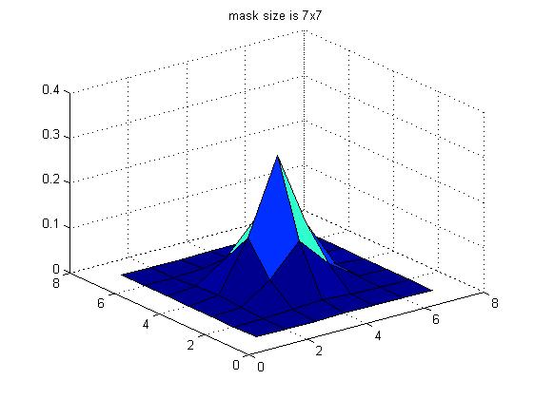
Gaussian Masks calculated by Matlab
function demo_gauss_mask1b %matlab code
clear, N=2
[X,Y]=meshgrid(-N:N,-N:N);sigma =N/4;
G=1/(2*pi*sigma^2)*exp(-(X.^2+Y.^2)/(2*sigma^2));
G=G./sum(G(:)) %normalise it
'sigma is ', sigma
'sum(G(:)) is ',sum(G(:))
'max(max(G(:))) is',max(max(G(:)))
figure(2), clf
surfc(G)
title ('mask size is 5x5')
%%%%%%%%%%%%%%%%%%%%%%%%%%%%%%%%%%%%%%%%%%%%%%%%%%%%%%%%
clear, N=3
[X,Y]=meshgrid(-N:N,-N:N);sigma =N/4;
G=1/(2*pi*sigma^2)*exp(-(X.^2+Y.^2)/(2*sigma^2));
G=G./sum(G(:)) %normalise it
'sigma is ', sigma
'sum(G(:)) is ',sum(G(:))
'max(max(G(:))) is',max(max(G(:)))
figure(3), clf
surfc(G)
title ('mask size is 7x7')
[X,Y]=meshgrid(-2:2,-2:2);sigma =0.5;
5x5 Gussian Mask
[X,Y]=meshgrid(-3:3,-3:3);sigma =0.75;
7x7 Gussian Mask

Slide 59
Exercise 3.6
Calculate the peak value
Answer: 1/(2*pi*0.75^2)=0.2829
Calculate the value of G when μ_{x}= μ_{y}=0 and
X=2σ,y=0, G=?
Ans:G=_________
X=3σ,y=0, G=?
Ans:G= _________
Sketch the shape of the function.
For the 7x7 2-D Gaussian mask ,
σ =0.75

Slide 60
Exercise 3.7
clear, N=2 %set N=2 will generate a mask of (2N+1)x(2N+1) = 5x5
[X,Y]=meshgrid(-N:N,-N:N);sigma =0.5;
G=1/(2*pi*sigma^2)*exp(-(X.^2+Y.^2)/(2*sigma^2));
G
sum(G(:)) %this is not 1, but the sum of all
% elements of the mask must be 1,so
G=G./sum(G(:)) %normalise it
G
pause
'sigma is ', sigma
'sum(G(:)) is ',sum(G(:))
'max(max(G(:))) is',max(max(G(:)))
figure(3), clf
surfc(G)
title ('mask size is 7x7')
sum(sum(G)) %you should find total sum is 1
Answer:
0.0000 0.0000 0.0002 0.0000 0.0000
0.0000 0.0113 0.0837 0.0113 0.0000
0.0002 0.0837 0.6187 0.0837 0.0002
0.0000 0.0113 0.0837 0.0113 0.0000
0.0000 0.0000 0.0002 0.0000 0.0000
Calculate the 5x5 2-D Gaussian mask , sigma =0.5
Show the steps.

Slide 61
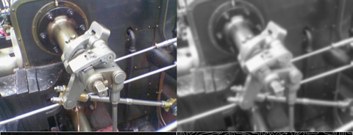
Result of smoothing an image by a Gaussian filter
Gaussain_filter * I = Guassian_filterd (I)
I
Guassian_filterd (I)

Slide 62
Laplacian filter
Second order derivative method

Slide 63
Second order edge detection method
I(x,y+1) I(x+1,y+1)
I(x,y) I(x+1,y)
We use gradient G of intensity [I(x,y)] change
First order gradient
I(x,y) is an edge if
Second order gradient (Laplacian operator), I(x,y) is an edge if
I(x,y)
y
x

Slide 64
Edge detection using second order gradient (Lapalcian)∇²I=G(G(I))=0
Sharp change of intensity levels
If (intensity gradient ∇²I =0)
{
pixel(x,y) is an edge point;
}
I(x,y)
G[I(x,y)]=> threshold is an edge
∇²I(x,y)= 0 is an edge
First order derivative
Second order derivative

Slide 65
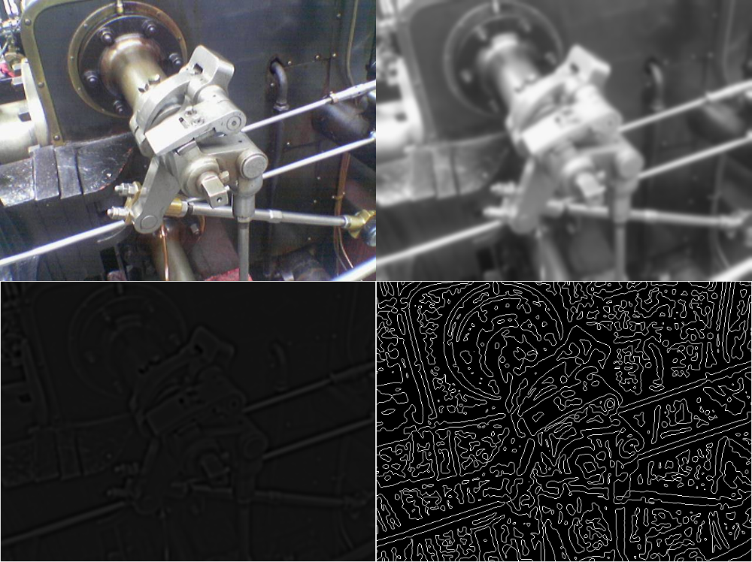
Result of applying second order filter (Laplacian filter)
Top left: Orginal image. Top right: After Gaussian blur filter. Bottom Left: Apply Laplacian filter on the blurred image. Bottom right: Edge after zero crossing

Slide 66
∇²I calculation by convolution*
Second order derivative of an image I w.r.t x and y
Similar to applying I to a 2nd-order-derivative filter
Or convolves a 2nd-order-derivative filter mask with I
That means: ∇²I =∇²*I
When ∇²I(x,y) =0, it is an edge
2nd-order-derivative filter : http://homepages.inf.ed.ac.uk/rbf/HIPR2/log.htm

Slide 67
Noise removal using Gaussian
∇²I(x,y) =0 is sensitive to noise
∇²G(I(x,y)) =0 , smooth first then find edge
In convolution you can
∇²G(I(x,y)) = (∇²G)*I(x,y) =0
Convolve a Laplacian operator (∇²G) with I
Idea: Second order differentiation of Gaussian distribution.
Application: smoothing and edge finding at one go

Slide 68
LOG (Laplacian of Gaussian) Put smoothing and edge detection together for better performance. Second order differentiation of Gaussian Application: smoothing and edge finding at one go
G(x)
Gaussian G
First order differentiation of G (Divergence of G) ∇G
Second order differentiation of G (Laplacian of G LOG) ∇²G
G(x)
x
m
∇G(x)
x
∇²G(x)
x

Slide 69
How to get the LOG (Laplacian of Gaussian) mask?
G(x)
1-D Gaussian
x
m
2-D Gaussian
y
x
m_{y}
m_{x}

Slide 70
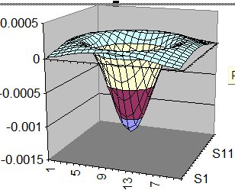
2nd derivative of G (x,y)=∇²G(x,y) =Laplacian of Gaussian (LoG)

Slide 71
Laplacian of Gaussian (LOG) method -- LOG is a 2nd order differentiation mask
2-D Mask
Laplacian of Gaussian (LOG)

Slide 72
Laplacian of Gaussian (LOG) by excel (cut and paste to excel to view plot)

Slide 73
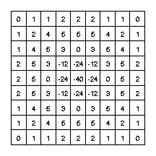
Method to reduce noise: Laplacian of Gaussian (LOG) method
Second derivative is sensitive to noise , so smooth it with a Gaussian smoothing filter first
It is like first blurring the image to remove noise then extract edges
LOG mask
http://homepages.inf.ed.ac.uk/rbf/CVonline/LOCAL_COPIES/OWENS/LECT6/node2.html

Slide 74
Canny Edge Detector
A practical non-linear filtering method
Very popular

Slide 75
Motivation
Using 1st derivative and 2nd derivative alone are not good enough to locate edges
1st derivate method gives “thick” edges.
2nd derivate method gives too much noise--“rings”.
First order method with thresholding is good but too simple. It cannot handle a wide range of images.
A threshold works for one image usually won’t work for another image.

Slide 76
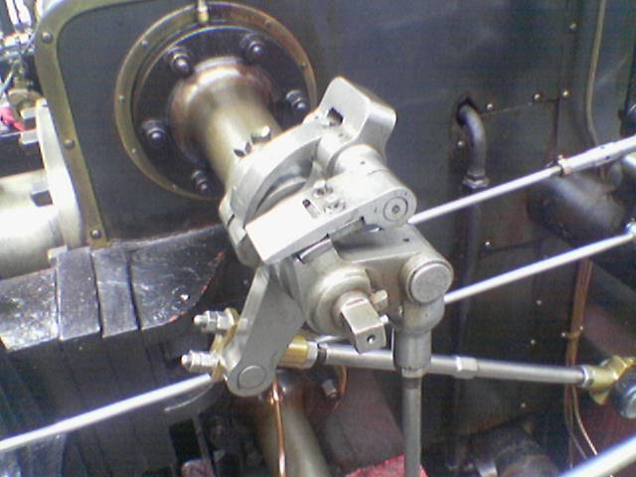
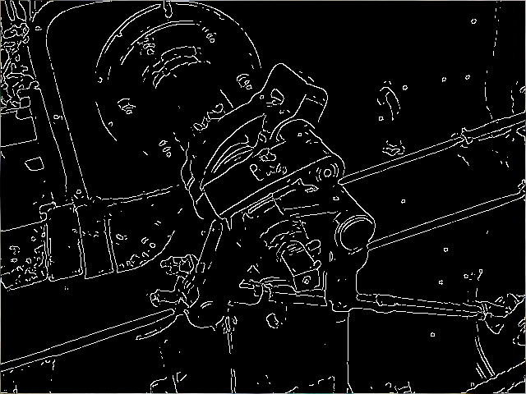
Goal
Mark as many real edges as possible.
The detected edges should be as close as the real edges.
All edges are of one pixel width.
Ref: http://en.wikipedia.org/wiki/Canny_edge_detector

Slide 77
Canny Edge Detector
It is first proposed by John F. Canny in 1986.
Use multiple stages to detect a wide range of edges.
It uses the 1st derivative of an image.
It takes a gray-level image as input.
Still one of the most used edge detectors in the world.

Slide 78
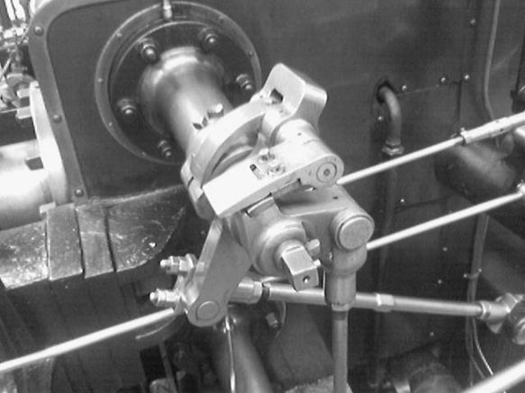

1st stage: Noise Reduction
Since it uses the 1st derivative of an image, it would be better to smooth the image first.
Usually, we convolve the image with a Gaussian filter to smooth the image.
*
=
Original Image
Gaussian filter
Smoothed Image

Slide 79
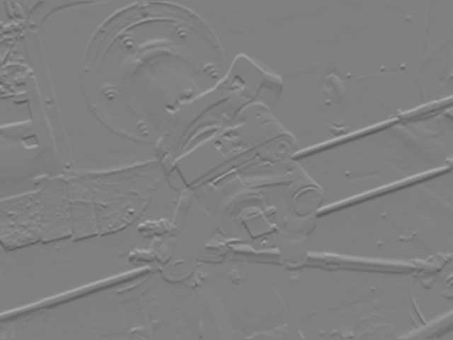
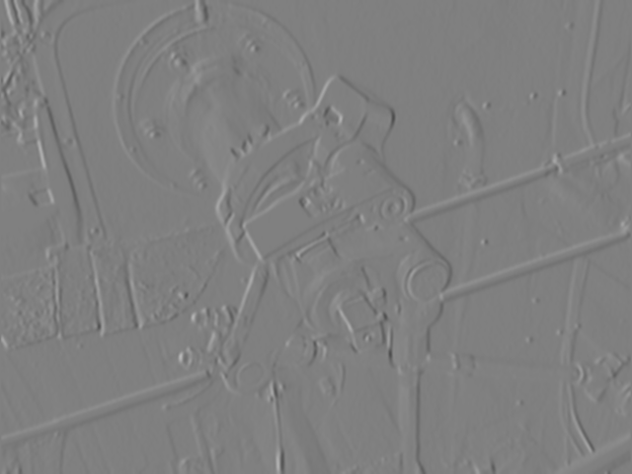
2nd stage: Find intensity gradient
Use some gradient operators (e.g. Prewitt, Sobel) to find Gx and Gy using the first order method, which requires a threshold set by the user.
Gx
Gy
*The image are scaled to show negative value for display purposes. You should notice that Gx responses to the vertical edges while Gy for horizontal edges.

Slide 80
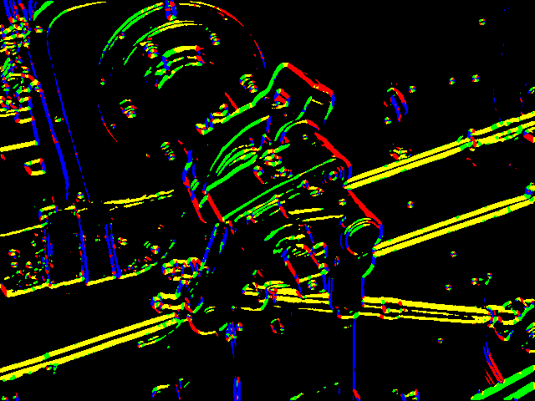
2nd stage: Find intensity gradient
Find the magnitude G and direction Θ of the gradient by:
That is: G = |Gx| + |Gy| Θ = tan⁻¹(Gy / Gx)
G
90
Θ (4 different colors)
135
45
0
0
Θ is rounded to 4 directions!!
0°, 45°, 90° and 135°!!!
45
135
90

Slide 81
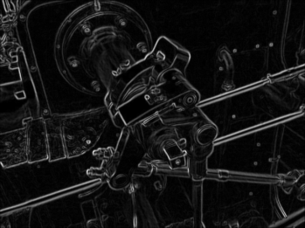
3rd stage: Non-maximum suppression
The gradient magnitude G almost gives us the edges of the image.
Let’s thin the lines in G.

Slide 82
3rd stage: Non-maximum suppression
Real edges are located at the maximum of the lines in G.
For each point (x,y), we compare the G(x,y) with its two neighbors along the Gradient Vector direction.
E.g. 25, 50, 17 in this example
The gradient vector direction is perpendicular to the edge direction.
Along gradient vector
direction
Gradient Vector
direction
G(x,y)
25
-----
50
-----
17
Edge
direction

Slide 83
3rd stage: Non-maximum suppression
If G(x,y) is greater than its two neighbors along the gradient direction, then (x,y) is set to remain. Non-maximum points are removed (suppressed ) in this process.
E.g we know G(x,y)’s direction (gradient vector direction) from Θ(x,y) and it is 90° because Gy is much bigger than Gx, Θ=tan⁻¹(Gy/Gx)≈90 °. Note:Θ is rounded to 4 directions!! : 0°, 45°, 90° and 135°
Then, we have to compare G(x,y) values along (the gradient vector direction) 25,50,17. G(x,y) =50 is found because 50 > 25 and 50 > 17.
Set the edge for position (x,y) as ‘1’. The others are ‘0’, so this edge is thin (one pixel wide) .
Along gradient vector
direction
G(x,y)
25
-----
50
------
17

Slide 84
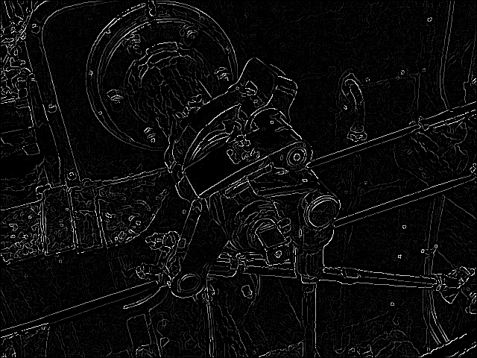
3rd stage: Non-maximum suppression
The lines are thinned into 1 pixel.
The result of non-maximum suppression:

Slide 85
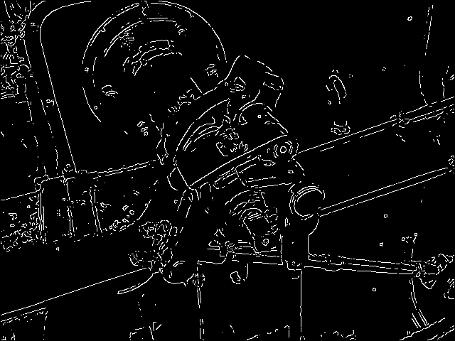
4th stage: Hysteresis Thresholding
We do thresholding (set in stage1) on the image twice with two different thresholds, t_{High} and t_{Low}.
t_{High} is applied first to remove edges that produced by noise (G(x,y)>T_{High}). Only edges with high gradient magnitude can survive. So many long edges are broken
Threshold
with t_{High}
Many broker edges
here

Slide 86
4th stage: Hysteresis Thresholding
For each remaining edges after threshold with t_{High}, we trace along the EDGE direction (perpendicular to gradient vector direction) and check whether its two neighbors are above t_{Low}, (G(x,y)>T_{low}).
If any of the neighbors is above t_{Low}, we mark this neighbor as edge point and recursively check its neighbor using the same logic.

Slide 87
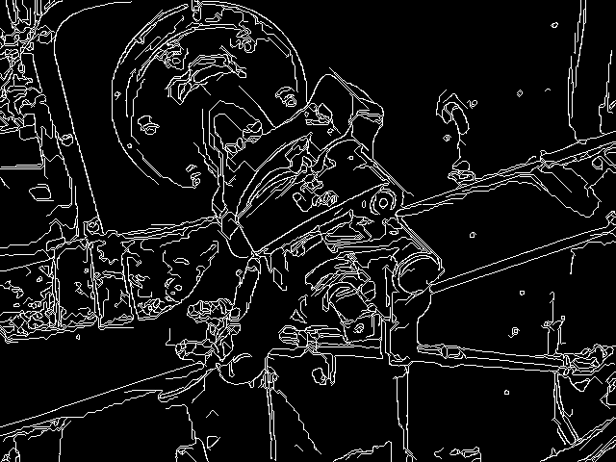
4th stage: Hysteresis Thresholding
Tracing along the edge with t_{Low} will connect the broken edges or restore segments removed by t_{High}.
Final result of Canny edge detection: one-pixel edges and few broken edges
After high thresholding

Slide 88
Worksheet 3.6
Write the algorithm for the Canny edge detector.
Answer:______________________
What is the advantage of using the Canny edge detector?
Answer:________________________

Slide 89
OpenCV
Since Canny edge detector is so popular, Intel’s Computer Vision library, namely OpenCV, has included this detector.
You can just call the build-in function Canny() and put corresponding parameters (e.g. the two thresholds) in it.
It is highly optimized and can be run in real time with a normal PC and Webcam.
More information: http://opencv.willowgarage.com/documentation/cpp/feature_detection.html?highlight=canny#Canny
http://www.pages.drexel.edu/~weg22/can_tut.html

Slide 90
Writing your own Canny edge detector
If you want to implement it yourself, you can still use OpenCV since it provides a lot of useful functions like Sobel() and gaussianBlur().

Slide 91
Conclusion
Studied edge detection techniques

Slide 92
Appendix

Slide 93
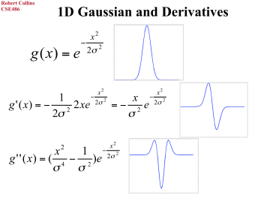
1d and 2d

Slide 94
Obtain a LOG mask by DoF Difference of Gaussian
Want to remove noise with low frequency (low fluctuation) and high frequency (high fluctuation).
That means band pass filtering
Solution
Difference of Gaussians DoG=
(Blurred version of I) – (Less blurred version of I)
DoG=G(kσ)- G(σ)

Slide 95
Intuition DoG (Difference of Gaussian) and LoG (Laplacian of Gaussian)
Using difference of 2 Gaussians to approx. 2nd derivative of G
Consider
G(σ) ≈ ∇ G(kσ)
DoG=G(kσ) - G(σ)
≈ G(kσ)- ∇ G(kσ)
≈ ∇² G(kσ) (2nd derivative)
G(x)
σ (less blurred)
kσ (blurred)
x
m
1-D DoG
See http://www.cse.yorku.ca/~kosta/CompVis_Notes/DoG_vs_LoG.pdf

Slide 96
Applying DOG Difference of Gaussian
Example
Using 2 Gaussian masks of standard deviations (σ=1 and kσ= 1.6) for the two blurred versions

Slide 97
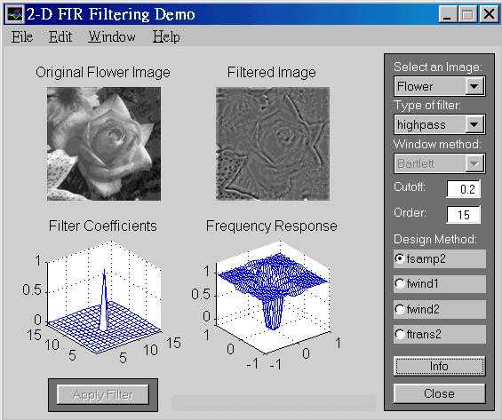
High pass filtering result

Slide 98
Use excel to plot a Gaussian distribution (cut and paste to excel to view plot)

Slide 99
Cmsc5711, Tutorial 3.1
x=[2 6 7;
4 6 9
1 3 2]
h=[1 -1
-1 1]
Z=x*h % * is the convolution operator
Find z. (Fully overlapping and half overlapping of x and h are considered, this is the formal definition of convolution)
What is the size of Z?
What is the value of h*x?

Slide 100
Answer Tutorial 3.1
Z=x*h
Find z. (Fully overlapping and half overlapping of x and h are considered, this is the formal definition of convolution):
ANSWER: Z=
2 4 1 -7
2 -2 2 -2
-3 0 -4 7
-1 -2 1 2
What is the size of Z? : answer: 4x4
What is the value of h*x?
Same as z
%Matlab
x=[2 6 7;
4 6 9
1 3 2]
h=[1 -1
-1 1]
conv2(x,h)
conv2(h,x)
Answer:
2 4 1 -7
2 -2 2 -2
-3 0 -4 7
-1 -2 1 2

Slide 101
Tutorial 3.2: Find horizontal edge image e_x=I*h_x and vertical edge image e_y=I*h_y
e_x=
e_y=

Slide 102
Answer: Tutorial 3.2
e_x=
ans =
0 0 0 0 0 0
0 0 0 0 0 0
0 1 1 0 -1 -1
0 1 1 0 -1 -1
0 1 1 0 -1 -1
0 0 0 0 0 0
e_y=
ans =
0 0 0 0 0 0
0 0 -1 -1 -1 0
0 0 -1 -1 -1 0
0 0 0 0 0 0
0 0 1 1 1 0
0 0 1 1 1 0
%Matlab
I=[0 0 0 0
0 1 1 1
0 1 1 1
0 1 1 1]
h_x=[0 0 0
1 0 -1
0 0 0]
h_y=[0 -1 0
0 0 0
0 1 0]
conv2(I,h_x)
conv2(I,h_y)

Slide 103
Tutorial 3.3: Intensity gradient of an image
Given
GI(x,y)
0 0 70.7107 60.8276 78.1025 14.1421
0 0 219.2442 467.1317 423.2493 369.1775
0 0 315.7847 614.3777 445.6591 577.0615
0 0 384.0000 768.0000 384.0000 768.0000
0 0 286.2167 640.0000 461.5106 572.4334
0 0 181.0193 461.5106 404.7715 362.0387
Find a formula to relate G(x,y) and ex and ey using the results as shown above
Answer:__________________________?
Write the edge image if the threshold is 500.
Answer:? __
ex=I*prewitt_x=
0 0 -50 -10 50 10
0 0 -178 -266 178 266
0 0 -306 -522 306 522
0 0 -384 -768 384 768
0 0 -256 -512 256 512
0 0 -128 -256 128 256
ey=I*prewitt_y =
0 0 50 60 60 10
0 0 128 384 384 256
0 0 78 324 324 246
0 0 0 0 0 0
0 0 -128 -384 -384 -256
0 0 -128 -384 -384 -256

Slide 104
Answer: Tutorial 3.3: Intensity gradient of an image
%Answer: matlab
I=[ 0 0 50 10
0 0 128 256
0 0 128 256
0 0 128 256]
pr_x=[-1 0 1
-1 0 1
-1 0 1]
pr_y=[1 1 1
0 0 0
-1 -1 -1]
e_x=conv2(I,pr_x)
e_y=conv2(I,pr_y)
e_total=sqrt(e_x.^2+e_y.^2)
GI(x,y)
0 0 70.7107 60.8276 78.1025 14.1421
0 0 219.2442 467.1317 423.2493 369.1775
0 0 315.7847 614.3777 445.6591 577.0615
0 0 384.0000 768.0000 384.0000 768.0000
0 0 286.2167 640.0000 461.5106 572.4334
0 0 181.0193 461.5106 404.7715 362.0387
Find a formula to relate G(x,y) and ex and ey
using the results as shown above
Answer: GI(x,y)=sqrt{ ex(x,y)^2 + ey(x,y)^2 }
Write the edge image if the threshold is 500. Or G(x,y)=
0 0 070.7107 060.8276 078.1025 014.1421
0 0 0219.2442 0467.1317 0423.2493 0369.1775
0 0 0315.7847 1614.3777 0445.6591 1577.0615
0 0 0384.0000 1768.0000 0384.0000 1768.0000
0 0 0286.2167 1640.0000 0461.5106 1572.4334
0 0 0181.0193 0461.5106 0404.7715 0362.0387
Or edge(x,y)
0 0 0 0 0 0
0 0 0 0 0 0
0 0 0 1 0 1
0 0 0 1 0 1
0 0 0 1 0 1
0 0 0 0 0 0
ex=I*prewitt_x=
0 0 -50 -10 50 10
0 0 -178 -266 178 266
0 0 -306 -522 306 522
0 0 -384 -768 384 768
0 0 -256 -512 256 512
0 0 -128 -256 128 256
ey=I*prewitt_y =
0 0 50 60 60 10
0 0 128 384 384 256
0 0 78 324 324 246
0 0 0 0 0 0
0 0 -128 -384 -384 -256
0 0 -128 -384 -384 -256
If G(x,y) >500,edge(x,y)=1
else edge(x,y)=0

Slide 105
Tutorial 3.4:Can you comment on what is the function of this convolution?
I*h_{lp}=
0 0 10.0000 20.0000 20.0000 10.0000
0 0 22.0000 54.0000 54.0000 22.0000
0 0 42.0000 96.0000 96.0000 42.0000
0 0 57.5000 135.0000 135.0000 57.5000
0 0 45.5000 116.5000 116.5000 45.5000
0 0 25.5000 51.0000 51.0000 25.5000

Slide 106
Answer 3.4:Can you comment on what is the function of this convolution?
%Matlab
I=[ 0 0 100 100
0 0 120 120
0 0 200 200
0 0 255 255]
h_low_pass=0.1*[1 1 1
1 2 1
1 1 1]
conv2(I,h_low_pass)
I*h_{lp}=
0 0 10.0000 20.0000 20.0000 10.0000
0 0 22.0000 54.0000 54.0000 22.0000
0 0 42.0000 96.0000 96.0000 42.0000
0 0 57.5000 135.0000 135.0000 57.5000
0 0 45.5000 116.5000 116.5000 45.5000
0 0 25.5000 51.0000 51.0000 25.5000
ANSWER: It is low pass filtering, the function is to blur the image.

Slide 107
Tutorial 3.5: Example for intensity gradient calculation
Given
(x1,y1)
GI(x,y)
0 0 70.7107 60.8276 78.1025 14.1421
0 0 219.2442 467.1317 423.2493 369.1775
0 0 315.7847 614.3777 445.6591 577.0615
0 0 384.0000 768.0000 384.0000 768.0000
0 0 286.2167 640.0000 461.5106 572.4334
0 0 181.0193 461.5106 404.7715 362.0387
Write a formula to find the direction of the edge image at pixel (x,y).
Answer:_______________?
Find the edge direction at (x1,y1)
Answer:_______________?
ex=I*prewitt_x=
0 0 -50 -10 50 10
0 0 -178 -266 178 266
0 0 -306 -522 306 522
0 0 -384 -768 384 768
0 0 -256 -512 256 512
0 0 -128 -256 128 256
ey=I*prewitt_y =
0 0 50 60 60 10
0 0 128 384 384 256
0 0 78 324 324 246
0 0 0 0 0 0
0 0 -128 -384 -384 -256
0 0 -128 -384 -384 -256

Slide 108
Answer: Tutorial 3.5: Example for intensity gradient calculation
Given
(x1,y1)
GI(x,y)
0 0 70.7107 60.8276 78.1025 14.1421
0 0 219.2442 467.1317 423.2493 369.1775
0 0 315.7847 614.3777 445.6591 577.0615
0 0 384.0000 768.0000 384.0000 768.0000
0 0 286.2167 640.0000 461.5106 572.4334
0 0 181.0193 461.5106 404.7715 362.0387
Write a formula to find the direction of the edge image at pixel (x,y)
Answer: Θ(x,y) = tan⁻¹(ey(x,y) / ex(x,y))
Find the edge direction at (x1,y1)
Answer: Θ(x1,y1) = tan⁻¹(ey(x1,y1) / ex(x1,y1))
Θ(x,y) =atan(384/(-266))
=-0.964980881 rad
ex=I*prewitt_x=
0 0 -50 -10 50 10
0 0 -178 -266 178 266
0 0 -306 -522 306 522
0 0 -384 -768 384 768
0 0 -256 -512 256 512
0 0 -128 -256 128 256
ey=I*prewitt_y =
0 0 50 60 60 10
0 0 128 384 384 256
0 0 78 324 324 246
0 0 0 0 0 0
0 0 -128 -384 -384 -256
0 0 -128 -384 -384 -256

Slide 109
Tutorial 3.6
Calculate the value of G(x,y) when μ_{x}= μ_{y}=0 and
X=-3*σ,y=0,G(x,y)=_____?
X=-2*σ,y=0,G(x,y)=_____?
X=-1*σ,y=0,G(x,y)=_____?
X=0*σ,y=0,G(x,y)=_____?
X=1*σ,y=0,G(x,y)=____?
X=2*σ,y=0,G(x,y)=____?
X=3*σ,y=0,G(x,y)=____?
Sketch G(x,y=0), assume y=0
For the 5x5 2-D Gaussian mask ,
σ =0.5
G(x,y=0)
x
-3σ -2σ -1σ 0 1σ 2σ 3σ

Slide 110
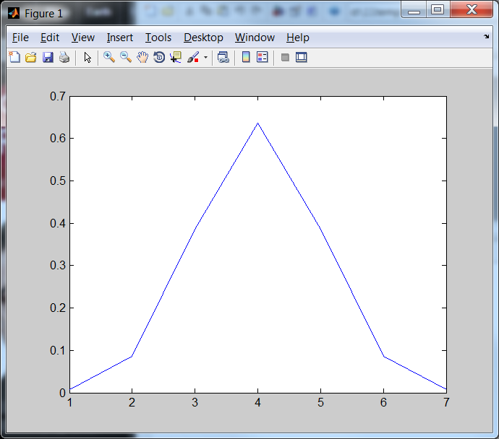
Answer: 3.6
Calculate the value of G(x,y) when μ_{x}= μ_{y}=0 and
%matlab, assume y is always at 0
Clear, sigma=0.5 , mean_x=0
for (i=1:7)
x=(i-4)*sigma
%will make x=-3,-2,-1,0, 1 ,2 ,2, 3
g(i)=(1/(2*pi*sigma^2))*...
exp(-(x- mean_x)^2/(2*sigma^2))
end
image (1),clf, plot(g)
Asnwer g(x=-3σ), g(x=-2σ), g(x=-1 σ), g(x=0), g(x=1 σ), g(x=2σ), g(x=3σ), =
g = 0.0071 0.0862 0.3861 0.6366 0.3861 0.0862 0.0071 (left / right mirro image)
For the 5x5 2-D Gaussian mask ,
σ =0.5
G(x,y) in 2D
-3σ -2σ -1σ 0 1σ 2σ 3σ
110

Slide 111
Tutorial 3.7
x=m_{x}
y=m_{y}
x=1+m_{x}
y=m_{y}
Fill in the blanks of this Gaussian mask of size 9x9 , sigma (σ)=2
Sketch the function
G(x,y)=
0.0007 0.0017 0.0033 0.0048 0.0054 0.0048 0.0033 0.0017 0.0007
0.0017 0.0042 0.0078 0.0114 0.0129 0.0114 0.0078 0.0042 0.0017
0.0033 0.0078 0.0146 0.0213 0.0241 0.0213 0.0146 0.0078 0.0033
0.0048 0.0114 0.0213 0.0310 0.0351 0.0310 0.0213 0.0114 0.0048
0.0054 0.0129 0.0241 0.0351 ____? ____? 0.0241 0.0129 0.0054
0.0048 0.0114 0.0213 0.0310 0.0351 ____? 0.0213 0.0114 0.0048
0.0033 0.0078 0.0146 0.0213 0.0241 0.0213 0.0146 0.0078 0.0033
0.0017 0.0042 0.0078 0.0114 0.0129 0.0114 0.0078 0.0042 0.0017
0.0007 0.0017 0.0033 0.0048 0.0054 0.0048 0.0033 0.0017 0.0007

Slide 112
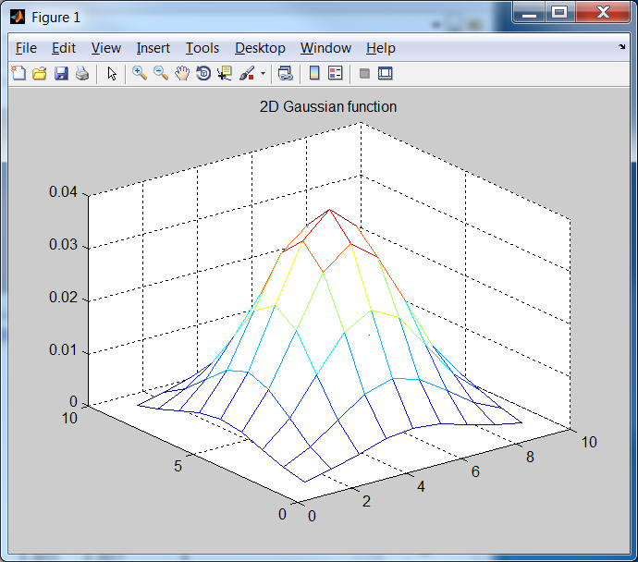
Answer: Exercise 3.7
1/(2*pi*2^2)*exp(-1/8)
x=m_{x}
y=m_{y}
x=1+m_{x}
y=m_{y}
1/(2*pi*2^2)
1/(2*pi*2^2)*exp(-2/8)
Fill in the blanks Gaussian mask of size the 9x9 , sigma (σ)=2
0.0007 0.0017 0.0033 0.0048 0.0054 0.0048 0.0033 0.0017 0.0007
0.0017 0.0042 0.0078 0.0114 0.0129 0.0114 0.0078 0.0042 0.0017
0.0033 0.0078 0.0146 0.0213 0.0241 0.0213 0.0146 0.0078 0.0033
0.0048 0.0114 0.0213 0.0310 0.0351 0.0310 0.0213 0.0114 0.0048
0.0054 0.0129 0.0241 0.0351 0.0398 0.0351 0.0241 0.0129 0.0054
0.0048 0.0114 0.0213 0.0310 0.0351 0.0310 0.0213 0.0114 0.0048
0.0033 0.0078 0.0146 0.0213 0.0241 0.0213 0.0146 0.0078 0.0033
0.0017 0.0042 0.0078 0.0114 0.0129 0.0114 0.0078 0.0042 0.0017
0.0007 0.0017 0.0033 0.0048 0.0054 0.0048 0.0033 0.0017 0.0007
clear %matlab
sigma=2 % in matlab , no -ve index for looping, so shift center to (5,5)
mean_x=5 , mean_y=5
for y=1:9
for x=1:9
g(x,y)=(1/(2*pi*sigma^2))*exp(-((x-mean_x)^2+(y-mean_y)^2) /(2*sigma^2))
end
end
mesh(g)
title('2D Gaussian function')

Slide 113
Worksheet 3.8
Can you describe what is a Gaussian distribution?
Answer:________________________
Write the algorithm for the Canny edge detector.
Answer:______________________
Why the Canny edge detector is so popular in image processing?
Answer:_________________________

Slide 114
Answer: tutorial 3.8
Can you describe what is a Gaussian distribution?
Answer:_in lecture notes
Write the algorithm for the Canny edge detector.
Answer:_in lecture notes
Why the Canny edge detector is so popular in image processing?
Answer: can output one pixel wide edges, easy to implement and can run in real time.

